Slide 1
HYPERTROPHIC CARDIOMYOPATHY
DR SREEJITH A.G

Slide 2
DEFINITION
HCM is a disease state characterized by unexplained LV hypertrophy associated with nondilated ventricular chambers in the absence of another cardiac or systemic disease.
Most common genetic cardiovascular disease
Prevalance 1:500 (
sudden death in young.
Notes:
that itself would be capable of producing the magnitude of hypertrophy evident in given patient-AS,HT,

Slide 3
GENETICS
Mendelian trait
autosomal dominant inheritance
Equal freq.in men & women
Women- progression to advanced heart failure
mutations in genes encoding protein components of the sarcomere and its constituent myofilament elements.

Slide 4
HCM GENES AND THEIR FREQUENCIES

Slide 5
More severe in gene positive,thick filament mutations

Slide 6
Beta MHC mutations-present late adolescents and develop substantial hypertrophy and more severe diseases.
MyBPC mutations -delayed clinical presentation age 50 or older,Less severe symptoms.
cTnT mutations- increased risk of sudden death
cTnI mutations- Greater predisposition of apical hypertrophy

Slide 7
Insights From Genotype/Phenotype Studies
autosomal dominant disease
Only 50% of the offspring
The offspring of unaffected family members - no risk of inheriting the gene and developing the disease.
In any one family with FHCM, all affected members have the same mutation.

Slide 8
MORPHOLOGY
Asymmetric hypertrophy with small left ventricular cavity
Diffuse hypertrophy of septum and anterolateral free wall(70-75%)
Basal septal hypertrophy(10-15%)
Concentric hypertrophy(5%)
Apical hypertrophy(<5%)
Hypertrophy of lateral wall(1-2%)

Slide 9
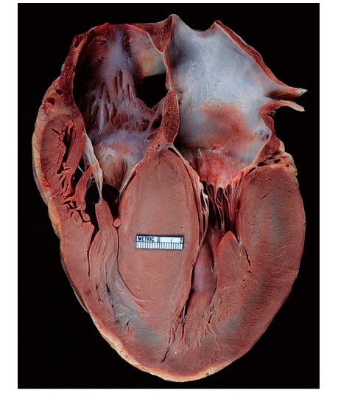

Slide 10
MITRAL VALVE APPARATUS
elongation of both leaflets
segmental enlargement of only anterior leaflet
mid portion of posteror leaflet
Congenital and anomalous anterolateral papillary muscle- produce muscular midcavity outflow obstruction
Notes:
insertion into the anterior leaflet without interposition of chordae tendineae and

Slide 11
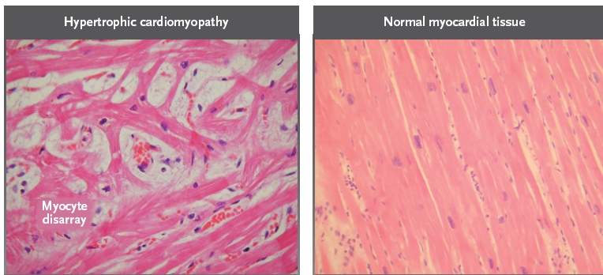
HISTOPATHOLOGY
Notes:
Myocardial disarray consists short runs of severly hypertrophied fibres interrupted by connective tissue
Myocardial fibrosis with degenerating muscle fibres
Volume of interstitial collagen increases

Slide 12
Abnormal intramural coronary arteries - thickened wall and narrow lumen near to areas of replacement fibrosis
Microvascular disease -silent myocardial ischemia - myocyte death replacement fibrosis

Slide 13
PATHOPHYSIOLOGY
LVOT OBSTRUCTION
Produced by SAM of mitral valve and midsystolic ventricular septal contact
SAM is abrupt anterior motion of the mitral valve in which elongated leaflets move toward the septum with a sharp-angled 90 degree bend

Slide 14
In the classic form - obstruction at the most basal portion of the septum
midventricular obstruction - hypertrophied papillary muscle
Most patients will have SAM of the anterior leaflet, also occur with the posterior leaflet.

Slide 15
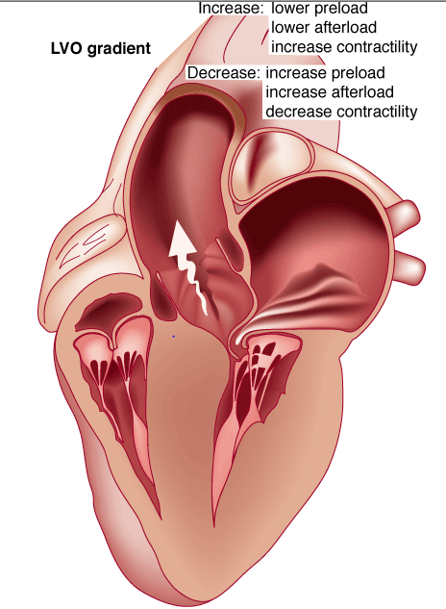
Obstruction is dynamic-varying with loading conditions and contractility of LV
Increase in contractility
VPC
Dobutamine,Isoproterenol
Exercise
Decrease in afterload/volume
Valsalva maneuver
Nitroglycerine/amylnitrite
Blood loss
dehydration

Slide 16
Dynamic Left Ventricular Outflow Tract Obstruction
Hemodynamic state | conditions | Outflow gradient
Basal obstuction | Rest | 30mmHg
Non obstructive | Rest | <30mmHg
 | Physiologically provoked | <30mmHg
Labile obstruction | Rest | <30mmHg
 | Physiologically provoked | 30mmHg

Slide 17
DIASTOLIC DYSFUNCTION
Impaired relaxation,filling and increased ventricular stiffness
Contributing to the symptoms
Rapid filling phase is prolonged
Decreased rate and volume of filling
Compensatory increase in atrial filling

Slide 18
MICROVASCULAR DYSFUNCTION
Myocardial ischemia is unrelated to epicardial coronary artery disease.
-supply demand mismatch due to
hypertrophy.
-abnormally small and partially
obliterated intramural coronary
arteries
myocardial scaring and replacement fibrosis -progressive heart failure and substrate for arrythmia

Slide 19
MITRAL REGURGITATION
Secondary to distortion of mitral valve apparatus from SAM.
The jet of MR is directed laterally and posteriorly and predominantly during late and mid systole
Severity proportional to LVOT obstruction.

Slide 20
CLINICAL FEATURES
Symptoms
Majority are asymptomatic
Dyspnoea - 90%( of symptomatic patients)
Syncope and presyncope in 20 and 50% respectively due to either hemodynamic or rhythm abnormality.

Slide 21
Angina -70-80%
small artery narrowing
intramural compression of small arteries
oxygen supply demand mismatch
abnormal coronary flow reserve

Slide 22
PHYSICAL EXAMINATION
Classic findings applied to patients with LVOT Obstruction
carotid pulse is brisk with spike and dome pattern
rapid rise (percussion wave) followed by a mid systolic drop followed by a secondary wave(Tidal wave)
Apical impulse:double or triple
Notes:
Midsystolic drop –premature closure of aortic valve
Late peak-reduction in gradient when the mitral leaflet returns to normal position
Fixed obstruction-decrease in both rate of rise and amplitude of pulse

Slide 23
Second heart sound:paradoxical split 20%
Fourth heart sound is present
Murmer: cresendo-decresendo at left sternal border.radiates to base as well as apex. Seldom radiates to carotid arteries
Dynamic auscultation: maneuvers that decrease preload will increase the dynamic gradient and increase intensity of murmer. Eg:standing and strain phase of valsalva
Notes:
Lbbb,lvoto

Slide 24
ECG
Abnormal in 95% of HCM patients
LVH seen in 70-80% patients
Abnormal Q waves -disturbance of activation of ventricular septum
Apical HCM:Diffuse symmetric T wave inversion across precordium
Atrial fibrillation:25-30% of patients

Slide 25
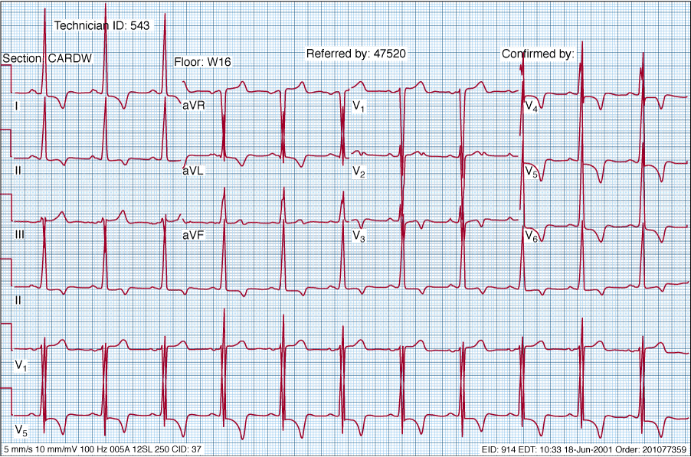

Slide 27
CARDIAC CATHETERIZATION
“ pull-back” pressure tracing
systolic gradient between the apex and base.
the small left ventricular cavity hyperdynamic systolic function- catheter "entrapment"
resulting in a falsely increased left ventricular systolic pressure
Notes:
Not necessary unless descrepancy bet echo n c/f
Endhole catheter in the lv apex and pulling back to base n aorta

Slide 28
ideally assessed by a simultaneous left ventricular inflow and left ventricular outflow (or aortic) pressure.
inflow position avoids the problem of catheter entrapment
Requires trans septal approach.

Slide 29
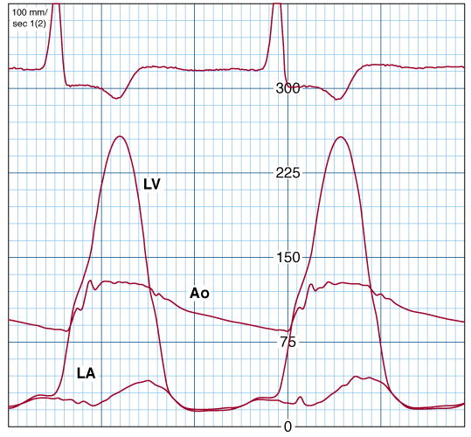

Slide 30
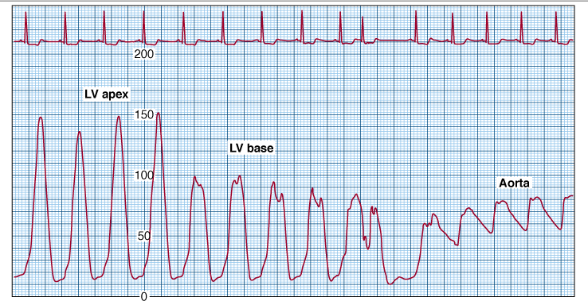

Slide 31
BROCKENBROUGH PHENOMENON
After a premature contraction-
increase in the contractility of the ventricle
marked increase in the degree of dynamic obstruction.

Slide 32
dynamic obstruction- increase in gradient and a decrease in the aortic pressure after the pause.
fixed obstruction - increase in stroke volume increase in aortic pulse pressure

Slide 33
LEFT VENTRICULOGRAPHY
small left ventricular cavity size with hypertrophied papillary muscles
Hyperdynamic systolic function - complete obliteration of the mid and apical cavity in systole
apical HCM - fixed obliteration of the apex by the hypertrophied muscle- "spade-like" configuration.

Slide 34
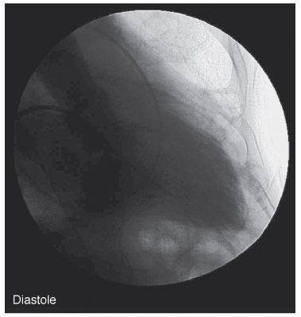
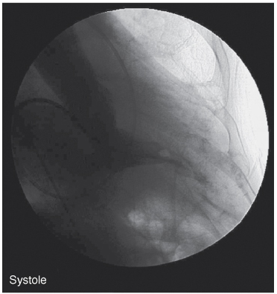

Slide 35
STRESS TESTING
Exercise is the most physiologic form of provocation to detect latent LVOT obstruction.
Important adverse prognostic factors
-decrease in blood pressure
- appearance of ventricular arrhythmias.

Slide 36
CMRI
More accurate than echo
Can detect 6% more hypertrophy
Accurate measurement of thickness
Should be done in
Poor echo window
Discrepancy between Clinical findings / ECG / Echo

Slide 37
CMR - Poor Prognostic factors
Markedly elevated LV mass index (men >
91 g/m^{2,} women > 69 g/m²) - sensitive(100%)
Maximal wall thickness of more than 30 mm specific (91%) for cardiac deaths

Slide 38
Right ventricular (RV) hypertrophy
Myocardial edema by T2-weighted imaging
LGE has been associated with
Ventricular arrhythmias
Progressive ventricular dilation

Slide 41
BURNTOUT HCM
3% manifest the end stage- systolic dysfunction (ejection fraction <50%)
Progressive heart failure
Often associated with AF
Patterns of LV remodeling
Wall thinning and cavity dilation,

Slide 42
Diffuse transmural scarring (the consequence of small-vessel mediated myocardial ischemia)
Progression to refractory heart failure or sudden death (10%/year).
The most reliable risk marker for evolution to the end stage is a family history of the end stage

Slide 43
echocadiography
a systematic echocardiography approach is necessary..
Confirming LV hypertrophy
Assessment of LVOT obstruction
Systolic anterior motion - SAM,
Assessment of systolic and diastolic LV function and left atrial size

Slide 44
Confirming the presence/absence of left ventricularhypertrophy
Unexplained maximal wall thickness >15 mm in any myocardial segment, or
Septal/posterior wall thickness ratio >1.3 in normotensive patients, or
Septal/posterior wall thickness ratio >1.5 in hypertensive patients.

Slide 45
Notes:
young population diffuse hypertrophy of the entire septum with a convex septal contour.
older population appearance of a "sigmoid" septum - hypertrophy is localized to the basal and midseptum

Slide 46
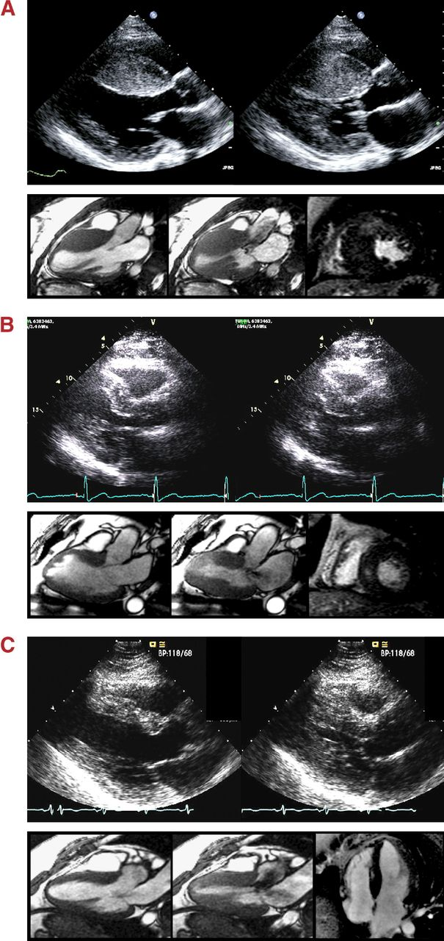
I mran S. Syed et al. JIMG 2008;1:377-379
American College of Cardiology Foundation
Notes:
A) Reverse curvature septum HCM shows a predominant mid-septal convexity toward the left ventricular (LV) cavity with the cavity itself often having an overall crescent shape. Dynamic subaortic obstruction is present in this example with systolic anterior motion (SAM) of the mitral leaflets and turbulent flow in the outflow tract. Prominent foci of MDE that indicate myocardial fibrosis are present in the anteroseptum and inferoseptum.
B) Sigmoid septum HCM shows a generally ovoid LV cavity with the septum being concave to the LV cavity and a prominent basal septal bulge
(C) Neutral septum HCM shows an overall straight septum that is neither predominantly convex nor concave toward the LV cavity

Slide 47
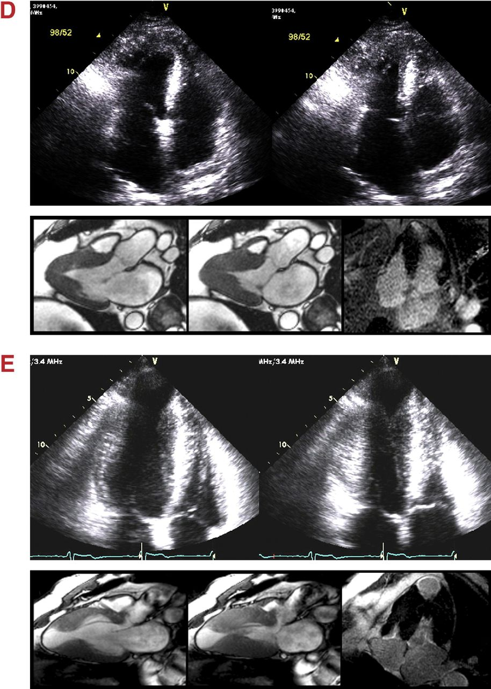
I mran S. Syed et al. JIMG 2008;1:377-379
American College of Cardiology Foundation
Notes:
(D) Apical HCM shows a predominant apical distribution of hypertrophy.
(E) Mid-ventricular HCM shows predominant hypertrophy at the mid-ventricular level

Slide 48
Systolic Anterior Motion (SAM)
•Drag effect >>> Venturi effect
•Anterior displacement of mitral valve and support apparatus; small LV cavity
•Septal encroachment into LVOT
•Mitral valve characteristics
•Anterior displacement of papillary muscles
•Unusual chordal attachments
•Elongated anterior leaflet

Slide 52
Y-interval from the beginning of SAM to the SAM-septalcontact X-duration of SAM-septal contact gradient is (x/y)*25 +25 mmHg
Notes:
reaching its peak before maximum movement of
the posterior wall

Slide 53
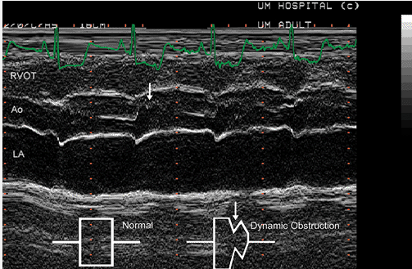
Notes:
M mode through aorta midsystolic closure or notching correlates with bisferiens pulse
Midsystolic notching, coarse systolic fluttering of the aortic valve, and fibrotic septal changes at the level of leaflet- septal contact are related echocardiographic features in obstructive HCM.

Slide 54
Mitral regurgitation
failure of normal leaflet coaptation - mitral regurgitation
typically mid-to-late systolic and inferolaterally oriented.
The presence of a central- or anteriorly directed jet --intrinsic mitral valve abnormality
Best 2D view for LVOT gradient-apical 3 chamber
LVOT jet is narrower than MR
Notes:
1.Doppler beam is parellel to LVOT,and can be directed away from lv inflow
2.Isovolumetric contraction is not included

Slide 56
DOPPLER ECHOCARDIOGRAPHY
Dynamic LVOT obstruction- a high-velocity "dagger-shaped" signal
In low outflow tract velocities(<3m/s)
provocation with the Valsalva maneuver,inhalation of amyl nitrite or exercise to determine a labile or latent obstruction.

Slide 57
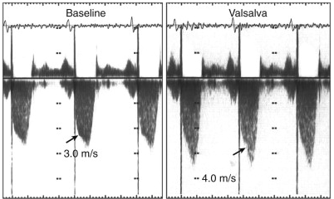

Slide 58
Presence and severity of mitral regurgitation
color jet directed laterally and posteriorly.
predominate in mid to late systole.

Slide 59
Dynamic LVOT obstruction - DDs
Elderly patients with hypertension treated with vasodilators, diuretics or digoxin
Postoperative period intravascular volume depletion and inotropic use.
AS after AVR
Mitral valve prolapse after MVR
Acute anterior-apical MI
Some patients with apical ballooning

Slide 60
Left atrial enlargement
indexing LA volume (derived from biplane area length or method of disks) to body surface area for quantification of LA size
normal indexed LA volume = 22 ± 6 ml/m2.
LA volume index of >34 ml/m2- a greater degree of LVH, severity of diastolic dysfunction, and adverse cardiovascular outcomes.
Notes:
diastolic dysfunction, mitral regurgitation, and atrial myopathy.

Slide 61
Tissue Doppler Imaging (TDI)
DTI of the mitral annular motion is abnormal despite normal or supranormal ejection fraction.
Abnormally low annular velocities - useful in detecting subclinical disease
Mean systolic annular motion Sa <9 cm/s - differentiating pathological LVH (HCM/hypertensive LVH) from physiological LVH ( accuracy of 92%)

Slide 62
Assessment of diastolic function
Doppler of mitral valve inflow, tissue Doppler velocities at the mitral annulus, pulmonary vein flow velocities, pulmonary artery systolic pressure and LA size and volume is recommended

Slide 63
Athlete's Heart Vs Hypertrophic Cardiomyopathy
HCM
Can be asymmetric
Wall thickness: > 15 mm
LA: > 40 mm
LVEDD :< 45 mm
Diastolic function: always abnormal
Athletic heart
Concentric & regresses
< 15 mm
< 40 mm
> 45 mm
Normal

Slide 64
Mid left ventricular HCM
Hypertrophy max at papillary muscle level
Lead to apical akinetic chamber
Diastolic paradoxical jet flow-
Notes:
Originates from apex and travel backwards towards LV chamber

Slide 65
Assessment of systolic function
Burnt out HCM- irreversible
Dynamic systolic dysfunction
During midsystole when the dynamic gradient is maximal -there is a transient fall in LV ejection flow
Pulsed doppler at the entrance of LVOT-mid systolic drop in velocities “lobster claw”

Slide 67
MANAGEMENT

Slide 68
SUDDEN CARDIAC DEATH
Most commonly in adolescents and young adults <30 - 35 years of age
initial clinical manifestation of HCM in asymptomatic individuals
Events are arrhythmia based- primary ventricular tachycardia and ventricular fibrillation

Slide 69
HIGH RISK
Secondary prevention
Prior cardiac arrest
Sustained ventricular tachycardia

Slide 70
Primary prevention- risk markers
1. Family history of one or more premature HCM-related deaths particularly if sudden and multiple
2. Unexplained syncope especially if recent and in the young
3. Hypotensive or attenuated blood pressure response to exercise
4. Multiple, repetitive or prolonged NSVT on serial ambulatory (Holter) ECG
5. Massive LV hypertrophy (wall thickness ≥30 mm)

Slide 71
POTENTIAL ARBITRATORS
Contrast-enhanced CMR _ delayed enhancement
LV apical aneurysms
The end-stage phase
Percutaneous alcohol septal ablation with transmural myocardial infarction

Slide 72
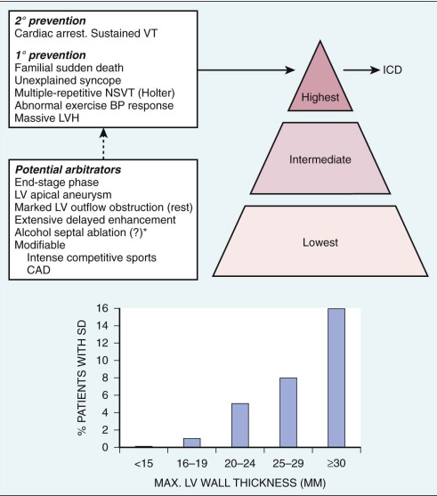
Risk Stratification

Slide 73
FAMILY SCREENING STRATEGY
Age <12 y
Optional unless:
Family history of premature death from
HCM

Slide 74
Age 12 to 18–21 y
Every 12–18 mo
Age >18–21 y
At onset of symptoms or at least every 5 y More frequent intervals are appropriate in families with late-onset HCM.

Slide 75
MEDICAL THERAPY
Initial therapeutic approach to relieving symtoms with obstructive HCM.
Beta -Adrenergic blocking agents are the initial drug of choice

Slide 76
Beta Blockers
Advantages of beta blockers include
1. Decreased heart rate response to exercise
2. Decreased outflow tract gradient with exercise
3.Relief of angina by a decrease in myocardial oxygen demand
4 Improvement in diastolic filling

Slide 77
Dosage should be titrated to symptom relief or to obtain a resting heart rate of <60 beats/min
May require up to 400 mg equivalent of metoprolol
No proven reduction in the incidence of SCD .

Slide 78
Calcium Channel Blockers
specifically verapamil and diltiazem
decrease inotropy and chronotropy
also improve abnormal diastolic relaxation by preventing calcium influx
Verapamil -used most frequently due to its minimal effect on afterload.

Slide 79
improvement in diastolic filling occurred with verapamil .
CCB’s may improve angina to a greater degree than beta blockers.
verapamil - sustained symptomatic improvement in <50% of patients
- resting heart rate of 60 beats/min and may require up to 480 mg/d.

Slide 80
Diltiazem
more vasodilating properties.
Dihydropyridines
will increase the severity of the outflow tract by reducing afterload

Slide 81
Disopyramide
The negative inotropic effect - decrease the gradient and improve symptoms.
Concomitant betablockade to prevent rapid atrioventricular node conduction.
dosage 300 to 600 mg/d.
corrected QT interval to be monitored

Slide 82
standard practice is to start betablocker as the initial therapy.
gradually increase to optimal dosages.
If patients cannot tolerate betablockers -a CCB, (verapamil) started

Slide 83
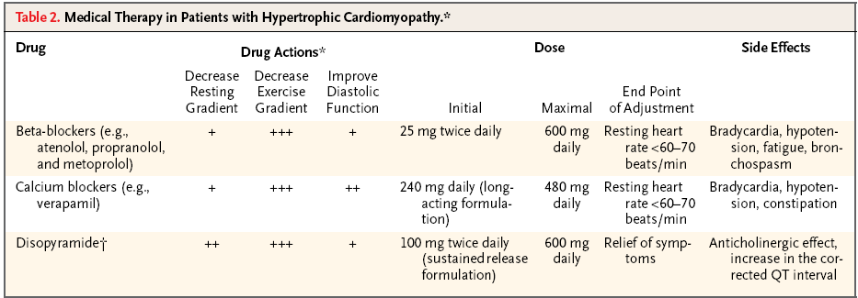

Slide 84
SEPTAL MYECTOMY (Morrow procedure)
Gold standard therapy for patients with obstruction and severe drug refractory symptoms

Slide 85
ELIGIBLE PATIENTS FOR MYECTOMY
Clinical:
Severe dyspnea or chest pain (NYHA classes III or IV) despite optimal medical therapy
Hemodynamic
Dynamic LVOT gradient at rest or with physiologic provocation 50 mm Hg associated with septal hypertrophy and SAM of the mitral valve.
Anatomic
Targeted anterior septal thickness sufficient to perform the procedure safely and effectively

Slide 86
Transaortic resection of 3 to 10gm muscle from the proximal to mid-septal region.
Enlarges the LVOT and significantly decreases or totally abolishes LVOT obstruction.
Mitral regurgitation secondary to SAM of the mitral valve also disappears

Slide 87
SEPTAL ABLATION
Injection of 1 to 3ml of 95% alcohol in to major septal perforator
Creates necrosis and permanent transmural MI in prox septum
Scar -10% of LV wall,<30% septum

Slide 88
Absence of significant coronary arterial disease
Compatible septal perforator branch arterial anatomy.
Relative contraindications to surgical myectomy(age,comorbidity)

Slide 89
Initial results reported successful short-term outcomes
The outflow tract gradient is reduced from a mean of 60 to 70 mm Hg often to <20 mm Hg.
75%-80% of patients are improved from the symptomatic standpoint

Slide 90
complications
Complete heart block. 10 to 20% require permenent pacemaker implantation
More likely to experience if LBBB was present prior.
Transmural scar – unstable electrical substrate-nidus forVT

Slide 91
Other complications
coronary dissections
large myocardial infarctions from "leakage" of the alcohol
ventricular septal defects
myocardial perforations

Slide 92
Conclusion
CONCLUSION
SA does seem to show promise in treatment of HOCM owing to similar mortality rates as well as functional status compared with SM, the caveat is increased conduction abnormalities and a higher post-intervention LVOTG. The choice of treatment strategy should be made after a thorough discussion of the procedures with the individual patient. (J Am Coll Cardiol 2010;55:823–34)

Slide 93
DDD Pacing
Objective measurements of exercise capacity did not differ significantly
Overall decrease in outflow tract gradient (25 to 40 % of baseline)
Role of dual-chamber pacing - patients at high risk for other therapeutic modalities.
Candidates for dual-chamber pacing
Significant bradycardia in which pacing may allow an increased dosage of medication
Patients who need ICD as a primary treatment

Slide 95
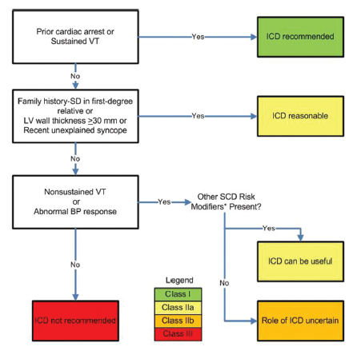
INDICATIONS FOR ICD

Slide 96
Treatment of Atrial fibrillation
Mc arrhythmia , occurs in 20 to 25%
Requires anticoagulation therapy
CHA2DS2VASc- not validated for HCM
Amiodarone-most effective in reducing recurrences
Beta blockers n verapamil-to control heart rate
Catheter ablation for atrial fibrillation -who have drug refractory symptoms or are unable to take anti-arrhythmic drugs

Slide 97
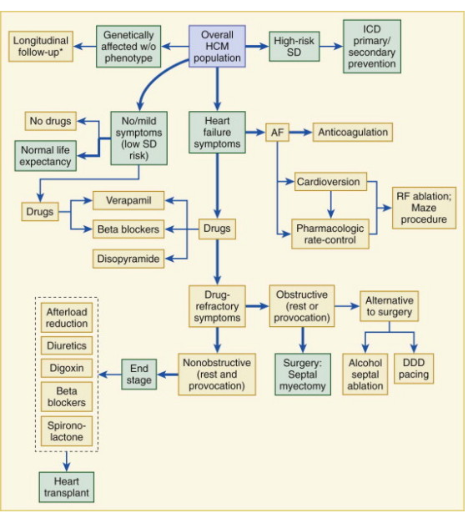

Slide 98
THANK YOU

